Slide 1
MAHI MISTRY MENTOR – Mr. MUNNA PANDEY
Unveiling Automobile Sales Trends Part 1 & 2

Slide 2
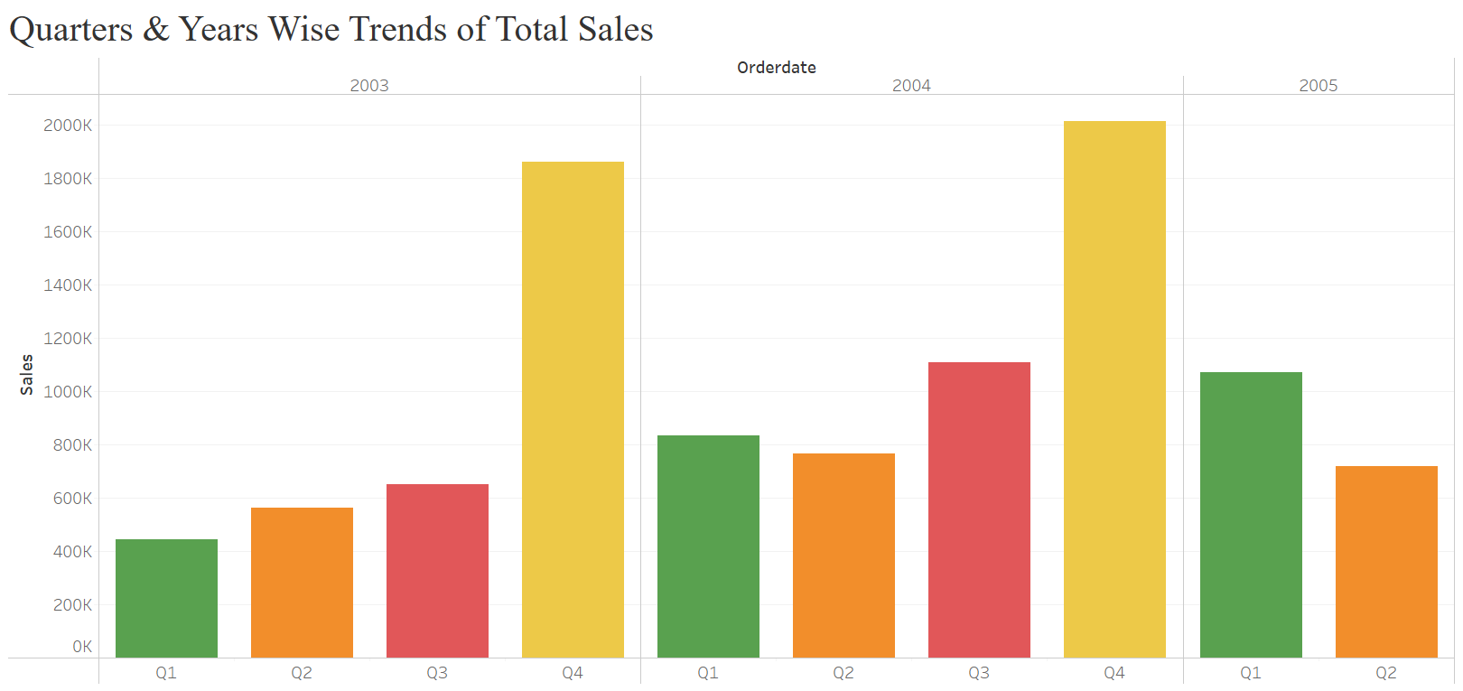
Project analysis slide 2
Sales Analysis
What is the trend in total sales amount over different quarters and years?
• This show trends of total sales over quarters & years that is in 2004, 4th Quarter have the maximum sales.
• Each group represents a year, with four columns (one for each quarter) side-by-side.

Slide 3
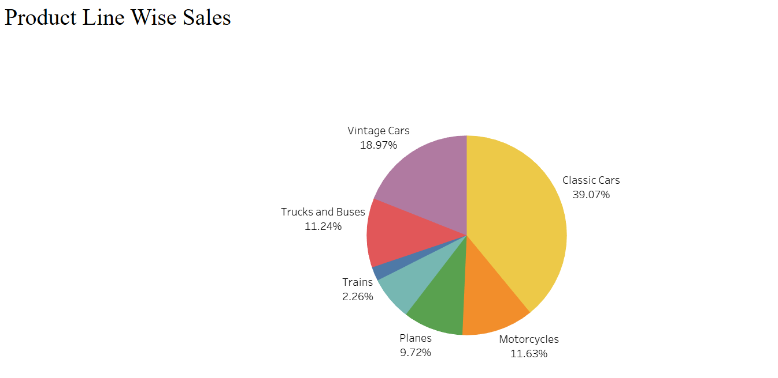
Project analysis slide 2
Sales Analysis
How do different product lines contribute to total sales?
• The largest slice of the pie represents the product line with the highest total sales.
• In this case, Classic Cars appears to be the dominant product line.
• Vintage Cars and Trucks and Buses seem to have significantly lower sales compared to Classic Cars and Motorcycles.

Slide 4
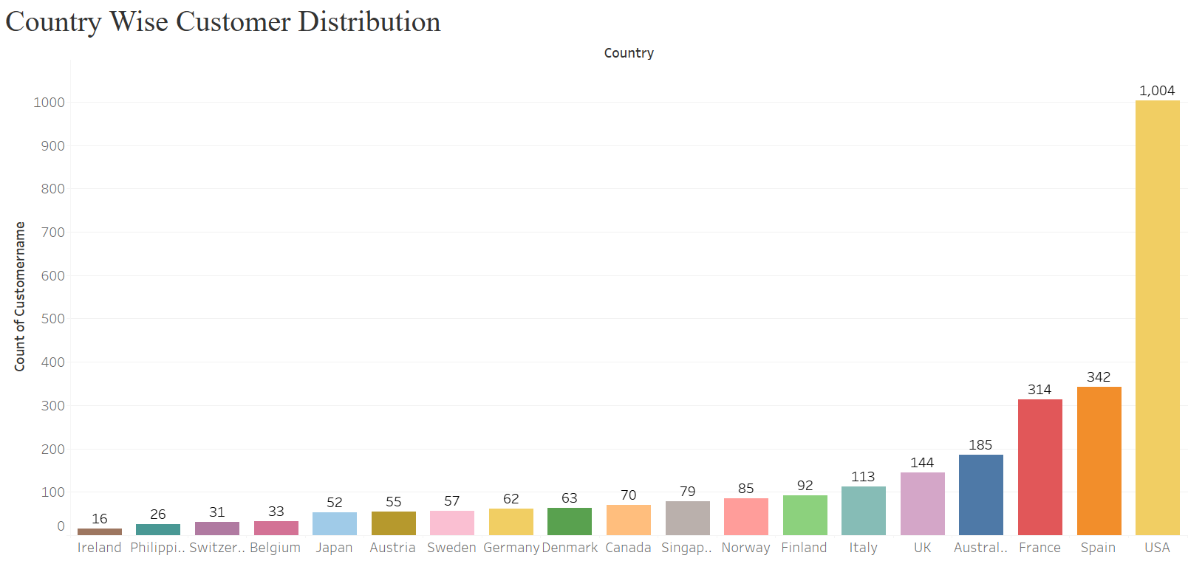
Project analysis slide 2
Customer Segmentation
What is the customer distribution in each country?
• The Top bars represent countries with the highest customer counts.
• Since each bar’s length directly corresponds to the number of customers, it’s easy to see how different countries compare.

Slide 5
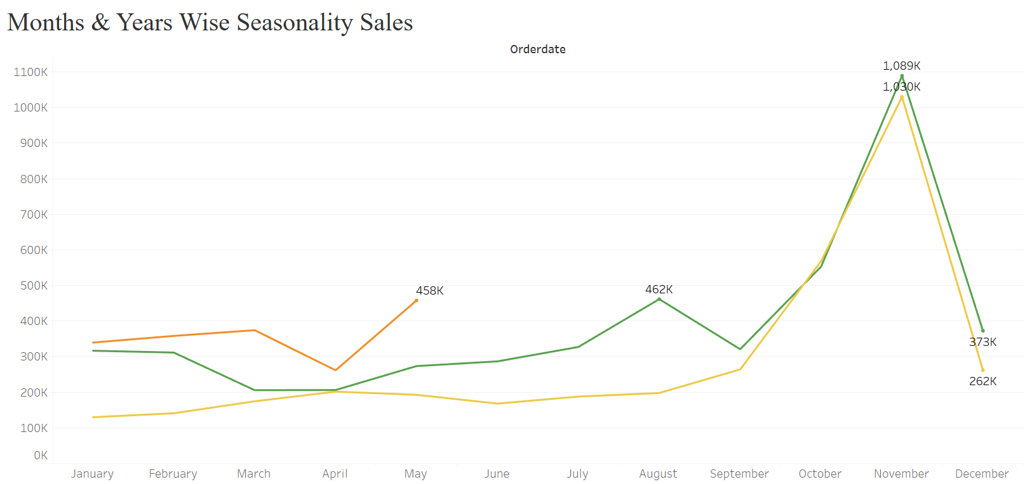
Project analysis slide 2
Sales Forecasting
Can you identify any patterns or seasonality in sales data?
• This line chart is designed to visualize the seasonal pattern of sales across different months and years.
• Sales tend to peak during the holiday season (November and December) and dip during the slower months.

Slide 6
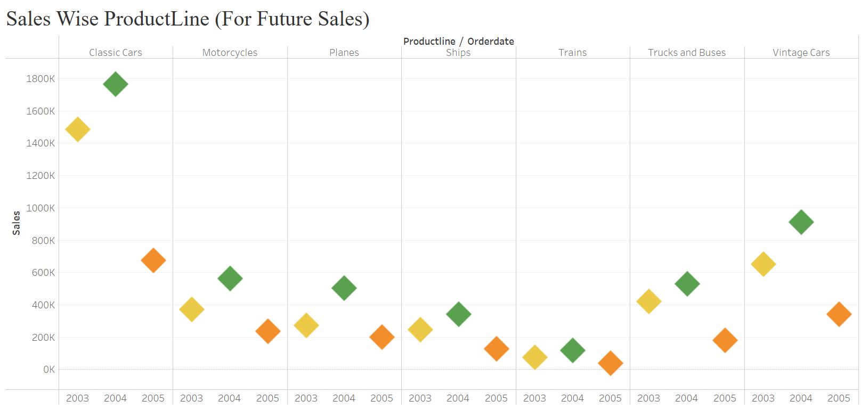
Project analysis slide 2
Sales Forecasting
What factors might influence future sales based on historical data?
• Each product line (Classic Cars, Motorcycles, etc.) is represented by a different colour
• You can compare the sales performance of different product lines across years.

Slide 7
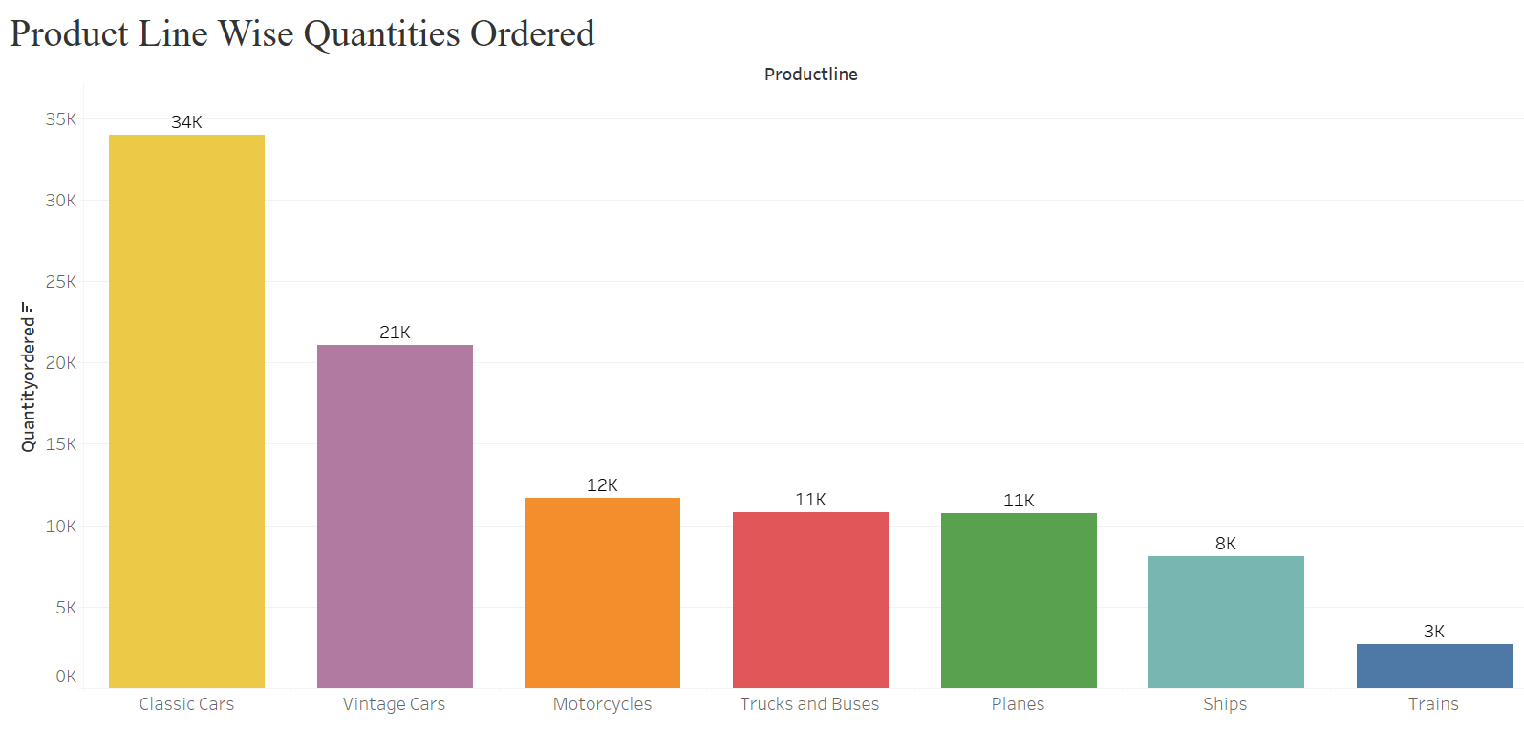
Project analysis slide 2
Product Performance
Which product lines have the highest and lowest quantities ordered?
• Highest Quantity Ordered: The Classic Cars product line has the highest quantity ordered with 967 units.
• Lowest Quantity Ordered: The Trains product line has the lowest quantity ordered with 77 units.

Slide 8
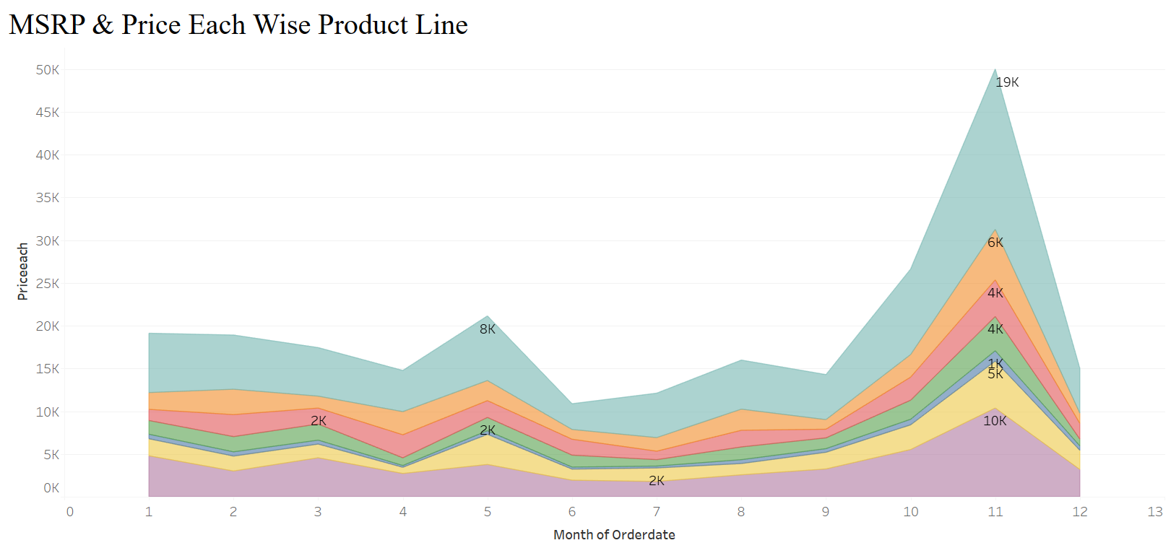
Project analysis slide 2
Price Strategy
Can you identify any patterns in pricing strategy based on product lines over the months?
• Classic Cars: This product line consistently has the highest sales throughout the year.
• Motorcycles: This line also shows a strong performance, especially during the peak season.

Slide 9
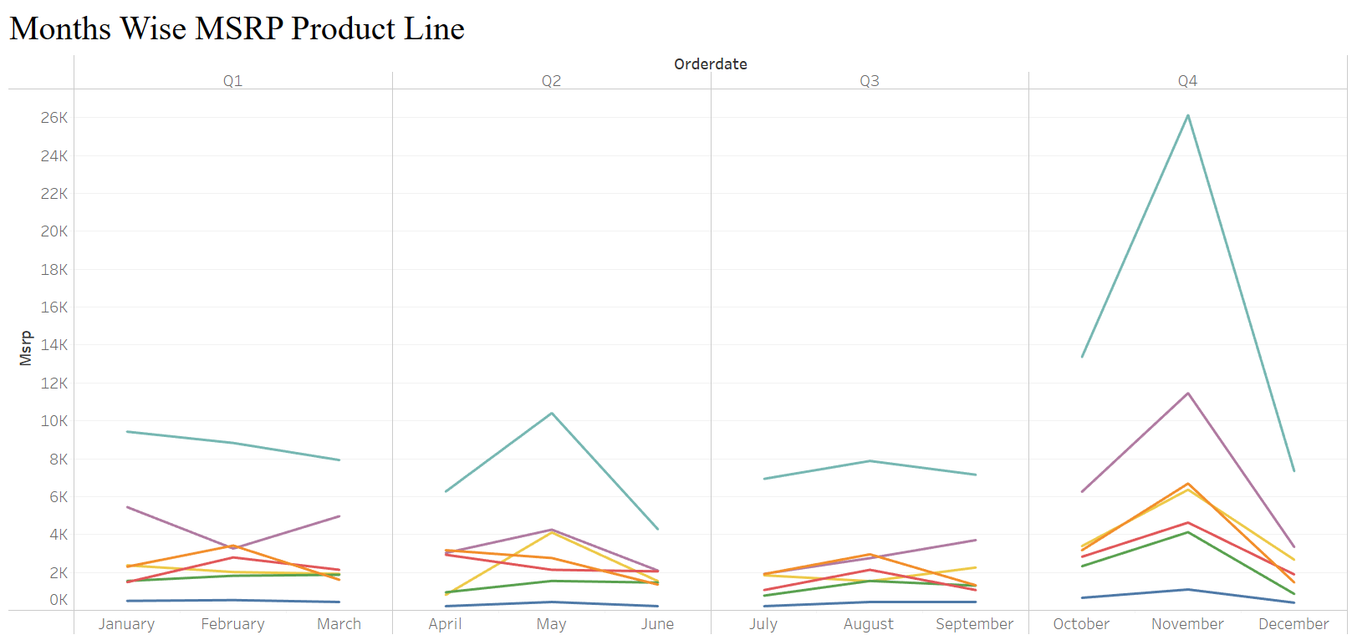
Project analysis slide 2
Price Strategy
How does the actual price (PRICEEACH) compare to the MSRP across different products?
• This visual helps you understand the individual pricing strategy for each product.
• If PRICEEACH is lower than MSRP, the product is likely discounted, while a higher PRICEEACH may indicate high demand or a luxury pricing approach.

Slide 10
Project analysis slide 2
Unveiling Automobile Sales Trends Part 1
Task 1:- Inventory Management
• The bar with the highest value at the top of the chart represents the product line with the highest quantity ordered that is Classic Car with 967.
• The bar with the lowest value at the bottom of the chart represents the product line with the lowest quantity ordered that is Trains with 77.
• Trend Analysis: An upward or downward trend in the line chart could indicate a change in overall demand, informing whether inventory levels need to be adjusted upwards or downwards. • This indicates that higher inventory levels for products with higher ordered quantities could meet demand effectively and maximize sales.
Task 2:- Order Fulfilment Analysis
• A Pie Chart for a high-level view of proportions if you want a quick sense of distribution.
• Shipped orders clearly dominate the pie chart, accounting for 92.26% of the total quantity ordered. This indicates that a significant majority of orders have been successfully fulfilled and shipped.
• here seems to be an upward trend in the quantity ordered over the quarters. The line generally slopes upwards, indicating increasing sales.
• The increase in sales could be due to various factors such as successful marketing campaigns, product launches, or seasonal trends.
Task 3:- Stocks & Order (Dashboard)
Product Line Wise Quantity Ordered
• Classic Cars is the best-performing product line, followed by Vintage Cars and Motorcycles.
Status Wise Quantity Ordered
• A very small portion of orders are Disputed, On Hold, Resolved, or Cancelled
Sales Wise Quantity Ordered
• The distribution of sales is skewed towards higher values.
• There are a few products with very high sales compared to the majority.
Month Wise Quantity Ordered
• January and February have the lowest sales, while December has the highest.

Slide 11
Task 4:- Pricing Strategy
• The difference in the height of the bars for each product line indicates the price difference between MSRP and PriceEach.
• The chart can help identify pricing strategies for different product lines, such as premium pricing or competitive pricing.
• This visual helps you understand the individual pricing strategy for each product.
• If PRICEEACH is lower than MSRP, the product is likely discounted
• Classic Cars: This product line consistently has the highest sales throughout the year.
• Motorcycles: This line also shows a strong performance, especially during the peak season.
Task 5: Sales & Customer Segmentation
The line chart shows a clear upward trend in sales from 2003 to 2005. The peak sales period seems to be towards the end of the year.
Classic Cars and Motorcycles dominate the sales, followed by Trucks and Buses.
Planes and Vintage Cars have the lowest sales contribution. APAC and EMEA regions seem to be the top-performing regions.
Task 6: Sales Forecasting
The accuracy of the forecast can be assessed by comparing the predicted values with the actual sales data. Factors like external economic conditions, market trends, and competitive landscape can influence forecast accuracy.
Task 7: Product Analysis
Classic Cars is the top-performing product line, with the highest quantity ordered.
Vintage Cars and Motorcycles follow closely behind. Planes, Ships, Trains, and Trucks and Buses have significantly lower quantities ordered.
Product-Level Performance: You can compare the performance of different products within a product line.

Slide 12
Unveiling Automobile Sales Trends Part 2
Task 1: Inventory Management
The bar with the highest value at the top of the chart represents the product line with the highest quantity ordered that is Classic Car with 967.
The bar with the lowest value at the bottom of the chart represents the product line with the lowest quantity ordered that is Trains with 77.
Peaks and Troughs: The area chart will help you see months with the highest and lowest order quantities. If you notice consistent peaks in certain quarters (eg:- Q4), it may indicate a seasonal demand spike.
levels for products with higher ordered quantities could meet demand effectively and maximize sales.
Task 2:- Order Fulfilment Analysis
A Pie Chart for a high-level view of proportions if you want a quick sense of distribution.
Shipped orders clearly dominate the pie chart, accounting for 92.26% of the total quantity ordered. This indicates that a significant majority of orders have been successfully fulfilled and shipped.
here seems to be an upward trend in the quantity ordered over the quarters. The line generally slopes upwards, indicating increasing sales.
The increase in sales could be due to various factors such as successful marketing campaigns, product launches, or seasonal trends.
Interpretation: Stocks & Order (Dashboard)
Product Line Wise Quantity Ordered:- Classic Cars is the best-performing product line, followed by Vintage Cars and Motorcycles.
Status Wise Quantity Ordered:- A very small portion of orders are Disputed, On Hold, Resolved, or Cancelled.
Quarter Wise Quantity Ordered:- There's a clear seasonal trend, with higher sales in the fourth quarter. Sales tend to decline in the first quarter and then gradually increase towards the end of the year.

Slide 13
Task 4:- Pricing Strategy
The difference in the height of the bars for each product line indicates the price difference between MSRP and PriceEach. The chart can help identify pricing strategies for different product lines, such as premium pricing or competitive pricing.
This visual helps you understand the individual pricing strategy for each product. If PRICEEACH is lower than MSRP, the product is likely discounted, while a higher PRICEEACH may indicate high demand or a luxury pricing approach.
Classic Cars: This product line consistently has the highest sales throughout the year.
This will show the distribution of prices within each product line, highlighting variations in median price and the spread of prices. Task 4e: This visual will help you see if there’s any correlation between price and sales volume. Clusters in certain areas of the chart might suggest effective price points for higher sales or potential overpricing if sales are low at higher price levels.
This chart will help you understand if certain deal sizes align with specific pricing strategies. For example, large deals may have more discounting, indicated by lower average PRICEEACH.
Task 5:- Price Strategy (Dashboard)
Product Line-Wise Pricing:
Classic Cars and Motorcycles: These product lines seem to have higher MSRPs compared to others, indicating premium pricing. Pricing Trends Over Time:
Seasonal Variations: The line charts show seasonal fluctuations in prices. There might be specific months or quarters where prices are higher or lower. Relationship Between Price and Sales:
A positive correlation between price and sales would indicate that higher prices lead to higher sales, while a negative correlation would suggest the opposite.

Slide 14
THANK YOU

